Slide 1
THE PAROTID REGION
Dr. Omotayo H A

Slide 2
THE PAROTID REGION
It includes:
The parotid salivary gland
The structures related to the gland

Slide 3
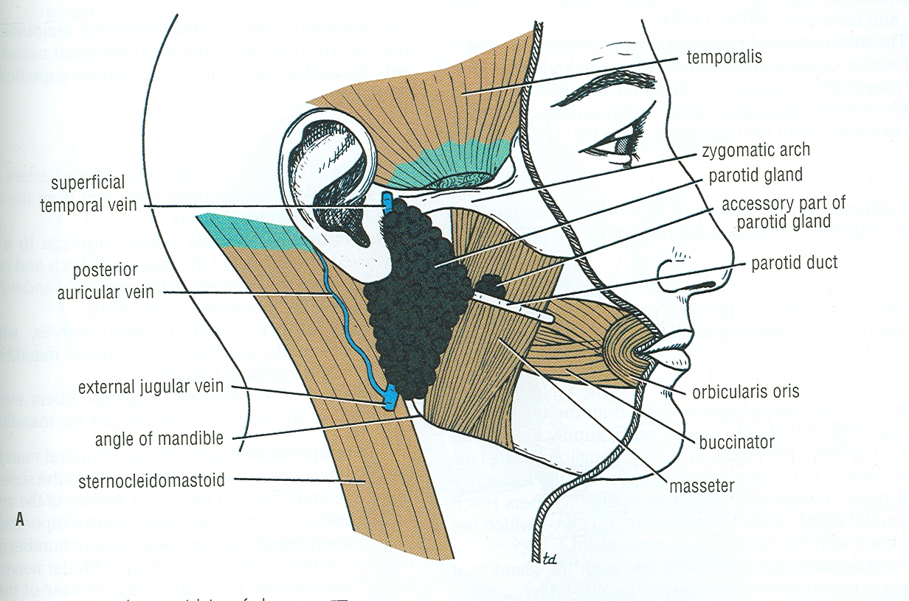
PAROTID GLAND

Slide 4
THE PAROTID GLAND
DEFINITION: It is the largest of the salivary glands
SITE: It lies below the auricle, occupying the region between ramus of mandible & mastoid process
EXTENT:
Superiorly: to zygomatic arch
Inferiorly: to angle of mandible
Anteriorly: to overlap posterior border of masseter
Posteriorly: to overlap anterior border of sternomastoid
SHAPE: Pyramidal

Slide 5
THE PAROTID GLAND
SUBDIVISIONS:
Main gland
Accessory gland: above parotid duct
CAPSULE:
Derived from deep fascia of neck (cervical fascia)
Its superficial layer is attached to zygomatic arch & extends to cover masseter
Its deep layer is attached to mandible, styloid & mastoid processes
A thickening of deep fascia extends from styloid process to angle of mandible (stylomandibular ligament) & separates the capsule of parotid from that of submandibular gland
It is tense (swellings of parotid gland are painful)

Slide 6
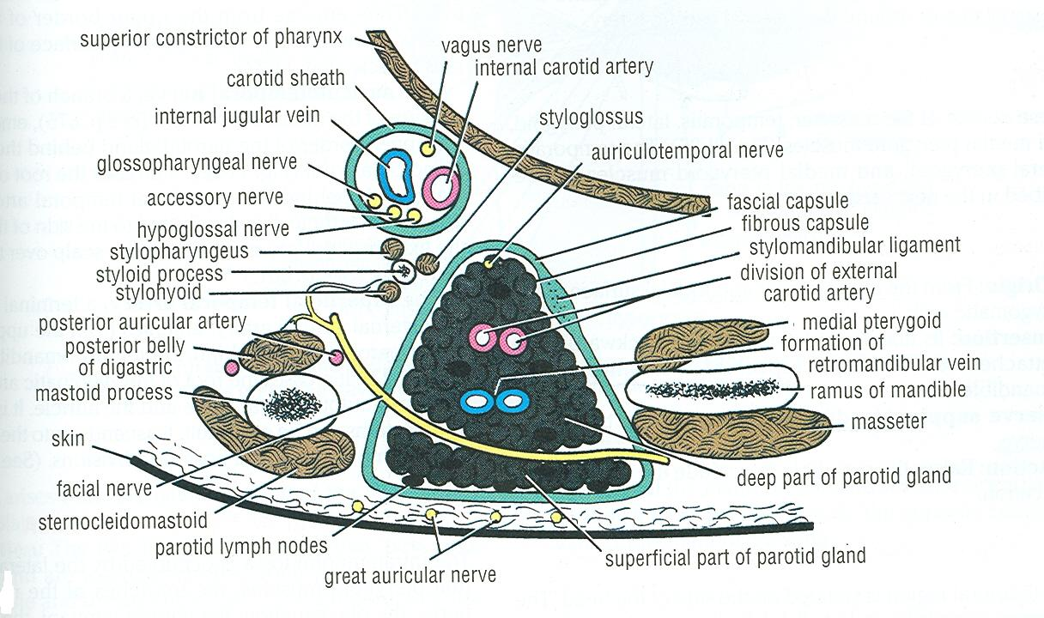
RELATIONS OF PAROTID GLAND

Slide 7
THE PAROTID GLAND
RELATIONS:
Superficial: skin, superficial fascia, great auricular nerve, superficial parotid (preauricular) lymph nodes
Anteromedial: posterior border of ramus of mandible + muscles attached to ramus (masseter, medial pteygoid)
Posteromedial: mastoid process + muscles attached to it (sternomastoid, posterior belly of digastric), styloid process + muscles attached to it (stylohyoid, styloglossus, stylopharyngeus), carotid sheath & its contents (internal jugular vein, internal carotid artery, 9th, 10th, 11th & 12th cranial nerves)
Medial: pharyngeal wall

Slide 8
STRUCTURES WITHIN THE PAROTID GLAND
Termination of facial nerve & beginning of its five terminal motor branches : most superficial structures
Terminations of superficial temporal & maxillary veins + the whole retromandibular vein + beginning of its two divisions (anterior & posterior)
Termination of external carotid artery & beginning of its two terminal branches (superficial temporal & maxillary): deepest structures
Deep parotid lymph nodes: embedded within substance of the gland

Slide 9
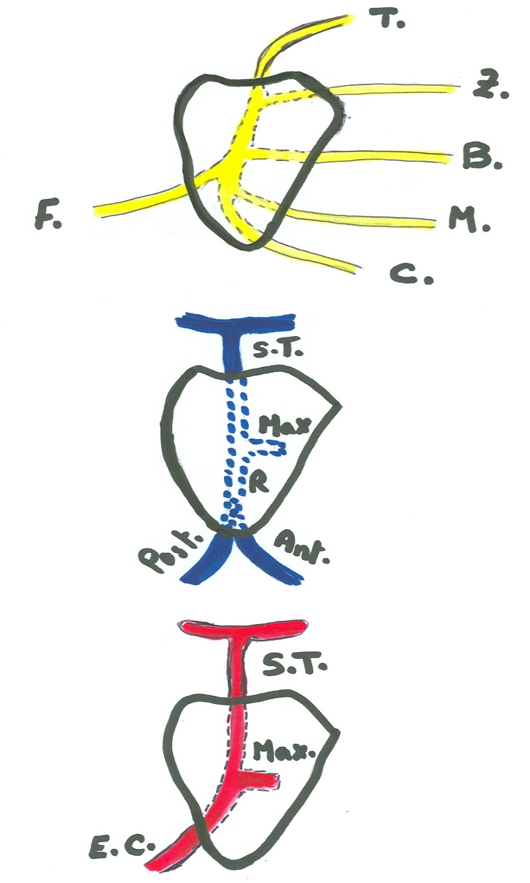
STRUCTURES WITHIN THE PAROTID GLAND

Slide 10
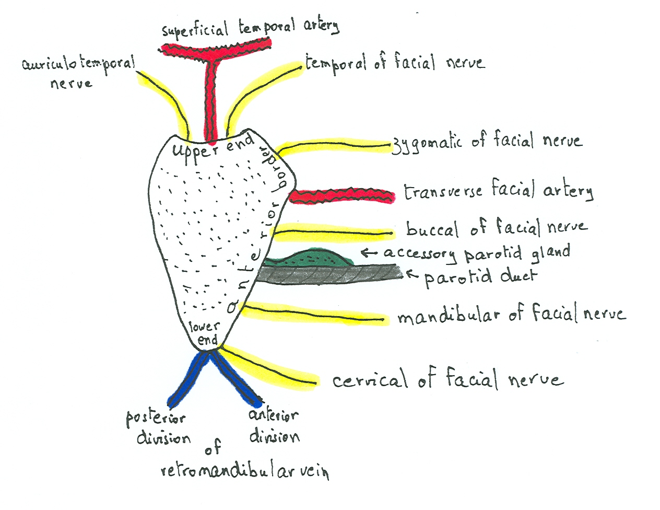
STRUCTURES EMERGING FROM THE PAROTID GLAND

Slide 11
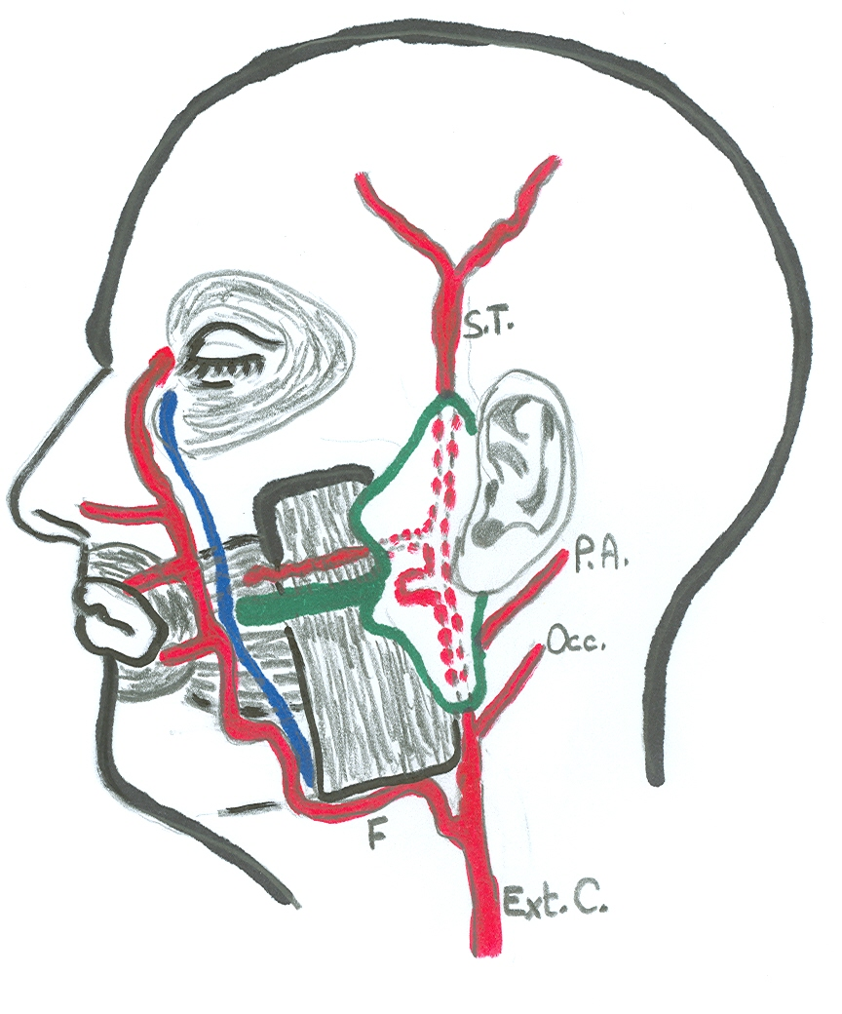
PAROTID DUCT

Slide 12
PAROTID DUCT
LENGTH: Two inches
COURSE & RELATIONS:
Emerges from anterior border of gland
Runs obliquely forwards, superficial to masseter & below transverse facial artery & accessory parotid
TERMINATION:
Pierces: buccal pad of fat, buccopharyngeal fascia, buccinator muscle & buccal mucosa
Opens: into the vestibule of mouth, opposite the crown of upper 2nd molar tooth
APPLIED ANATOMY: The oblique passage of the duct act as a valve-like mechanism & prevents inflation of the duct during blowing
SURFACE ANATOMY: It is represented by the middle 1/3 of a line extending from the tragus of the auricle to a point midway between the ala of nose & upper lip

Slide 13
NERVE SUPPLY
PARASYMPATHETIC (SECRETORY):
Origin: inferior salivary nucleus (medulla)
Preganglionic fibers: run along the lesser petrosal nerve (branch of tympanic of glossopharyngeal (9th cranial)
Ganglion: fibers relay in the otic ganglion (infratemporal fossa)
Postganglionic fibers: reach the parotid gland along auriculotemporal nerve (branch of mandibular of trigeminal)
SYMPATHETIC: Postganglionic sympathetic fibers reach the gland as a plexus around external carotid artery

Slide 14
BLOOD SUPPLY
ARTERIES: External carotid
VEINS: Retromandibular vein

Slide 15
LYMPHATIC DRAINAGE
Into superficial & deep parotid lymph nodes
Finally into deep cervical lymph nodes

Slide 16
APPLIED ANATOMY
Parotiditis
Parotid tumour
frey’s syndrome: sweating and flushing of a patch of skin near the ear that occurs when someone is eating foods with more intense flavours such as sour,spicy or salty foods. A rare complication of surgery or an injury of the parotid gland in the cheek

Slide 17
APPLIED ANATOMY
sjogren,’s syndrome: an immune system disorder characterised by dry eyes and dry mouth. Often occur with other disorders like rheumatoid arthritis and lupus

Slide 18


